Slide 1
ShanghaiTech University
EE 115B: Digital Circuits
Fall 2021
Lecture 16
Hengzhao Yang
December 7, 2021

Slide 2
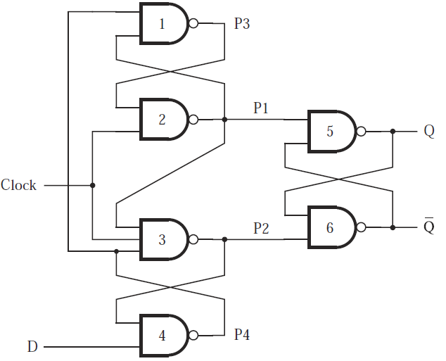
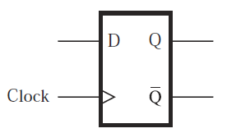
Edge-triggered D flip-flop: positive
Circuit and circuit symbol

Slide 3
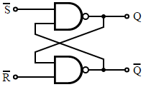
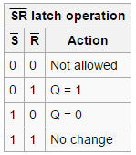
Edge-triggered D flip-flop: positive
Clock=0
  P1=1, P2=1, basic S’R’ latch holds
  P4=D’, P3=D
Positive edge
  P1=(P3 AND Clock)’=D’
  P2=(P1 AND Clock AND P4)’=D
  Q=P1’=D, Q’=P2’=D’ (latch: S’=P1, R’=P2)

Slide 4
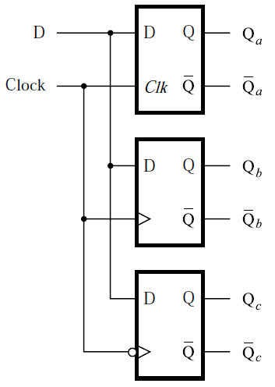
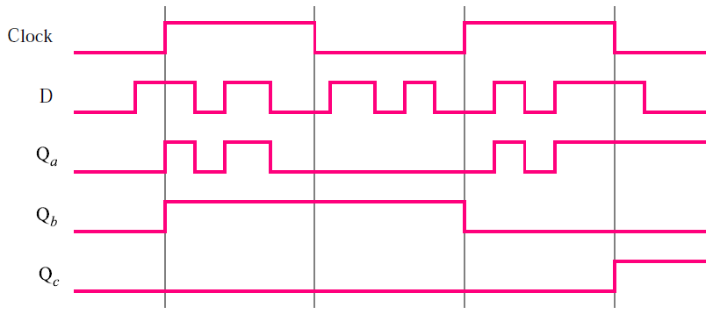
D: latch vs. flip-flop
Top to bottom
  Gated D latch (level sensitive)
  Positive-edge-triggered flip-flop
  Negative-edge-triggered flip-flop

Slide 5
D flip-flops with CLEAR and PRESET
Control signals: CLEAR and PRESET
  Use CLEAR to set initial condition Q=0
  Use PRESET to set initial condition Q=1
Implementations
  Based on master-slave D flip-flop
  Based on edge-triggered D flip-flop

Slide 6
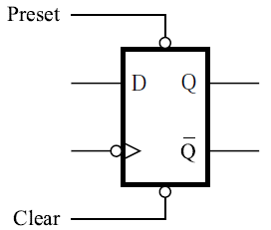
Master-slave D flip-flop with CLEAR and PRESET
CLEAR and PRESET are active low
  CLEAR=0: Q=0
  PRESET=0: Q=1
  CLEAR=1 or PRESET=1: no effect
Circuit symbol (negative edge)

Slide 7
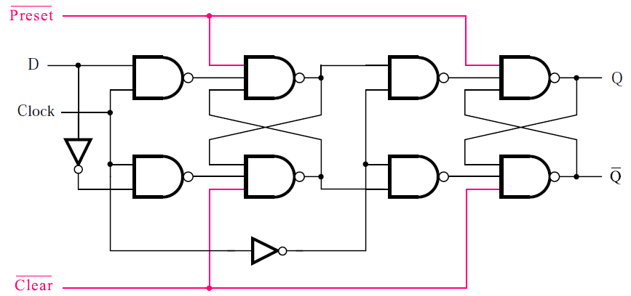
Master-slave D flip-flop with CLEAR and PRESET
Circuit: modified master-slave D flip-flop

Slide 8
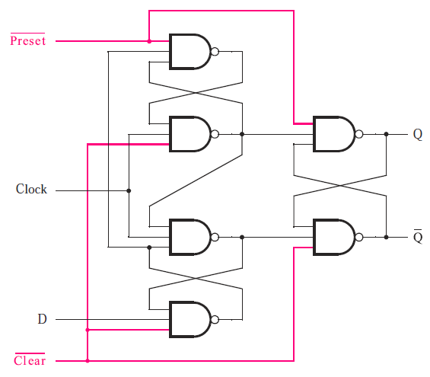
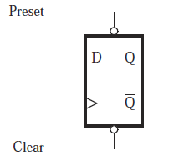
Edge-triggered D flip-flop with CLEAR and PRESET
Circuit and circuit symbol (positive edge)

Slide 9
Asynchronous vs. synchronous CLEAR
Asynchronous CLEAR
  If CLEAR=0, flip-flop will be cleared to Q=0 immediately without regard to clock
Synchronous CLEAR
  If CLEAR=0, flip-flop will be cleared to Q=0 at the next clock edge (positive or negative)

Slide 10
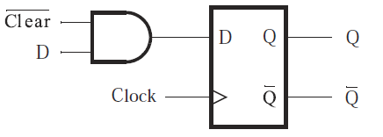
Synchronous CLEAR
Circuit

Slide 11
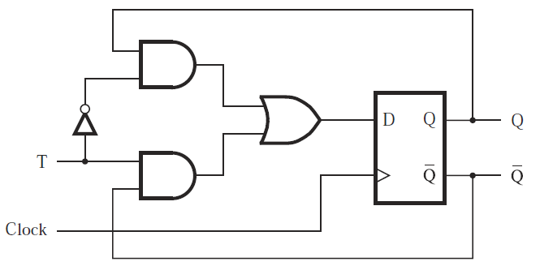
T flip-flop
T flip-flop
  T=0: state does not change
  T=1: state is reversed
Circuit

Slide 12
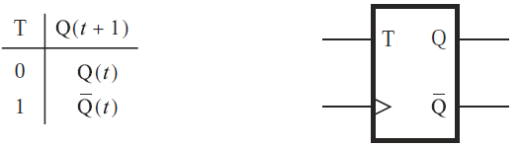
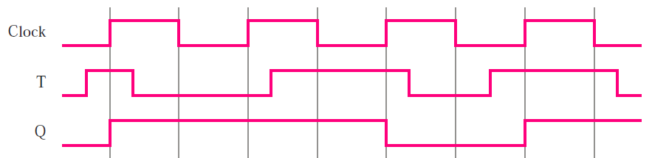
T flip-flop
Characteristic table and circuit symbol
Timing diagram

Slide 13
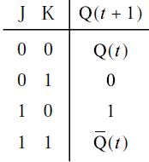
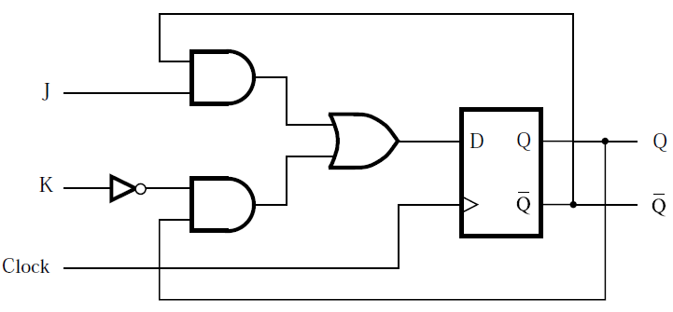
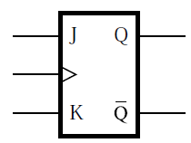
JK flip-flop
JK flip-flop
  Combines behaviors of basic SR latch and T flip-flop
  J: set, K: reset
Circuit, characteristic table, and circuit symbol

Slide 14
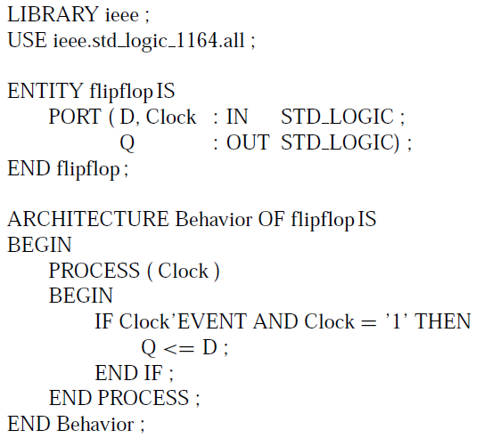
Code for D flip-flop (positive edge)
Code
  Sensitivity list: Clock
  ’EVENT: signal attribute
  Clock’EVENT: any change in the Clock signal
  Clock’EVENT AND Clock=‘1’: clock signal value has changed and the value is now 1 (positive edge)

Slide 15
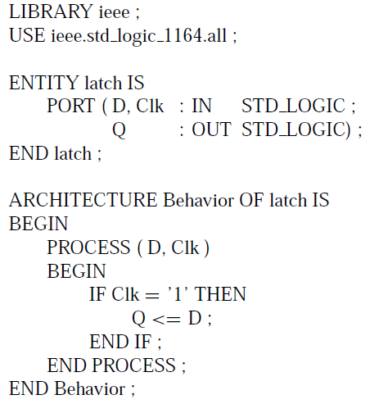
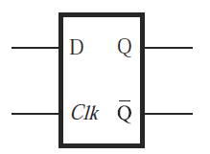
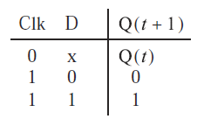
Comparison: VHDL code for gated D latch

